Slide 1
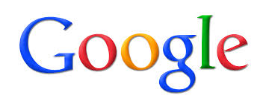

Founded in 1998

Slide 2
QUICK FACTS
Company Name: Google Inc
Ticker Symbol: GOOG(Nasdaq)
Headquarters: Amphitheatre Parkway, Mountain View, California, United States of America
Year of incorporation: 1998
Year of IPO: 2004
Number of shares outstanding: 334.09 million
Number of employees: 53,861 full-time employees
Industry: Internet, Computer Software, Telecom Equipment
Chief Executive Officer: Larry Page
Executive Chairman: Eric Schmidt

Slide 3
INDUSTRY OVERVIEW
Macroeconomic Factors
Internet search is applicable to most cultures all over the world freeing Google from geographic dependence.
It has a relatively young user base. This means that it will be less affected as the Baby Boomers age in comparison to other companies that depend on the 50 to 60 year-old demographic group.
The crucial need to stay informed and constantly connected keeps such services vibrant despite the sluggish economies.
Google has also faced concern on copyright issues because the company stores copies of third party web pages and images on their servers. They have responded to this criticism by releasing a copyright information page

Slide 4
PEST ANALYSIS
This form of business analysis examines the external environment of a business.
It can provide a quick and visual representation of the external pressures facing a business
It is usually divided into four external influences on a business
P – Political
E – Economic
S – Social
T – Technological

Slide 5
POLITICAL
Political stability
Risk of military invasion
Legal framework for contract enforcement
Intellectual property protection
Trade regulations & tariffs
Favored trading partners
Anti-trust laws
Pricing regulations
Taxation - tax rates and incentives

Slide 6
ECONOMIC
Type of economic system in countries of operation
Government intervention in the free market
Comparative advantages of host country
Exchange rates & stability of host country currency
Efficiency of financial markets
Infrastructure quality
Skill level of workforce

Slide 7
SOCIAL
Demographics
Class structure
Education
Culture (gender roles, etc.)
Entrepreneurial spirit
Attitudes (health, environmental consciousness, etc.)
Leisure interests

Slide 8
TECHNOLOGICAL
Recent technological developments
Technology's impact on product offering
Impact on cost structure
Impact on value chain structure
Rate of technological diffusion

Slide 9
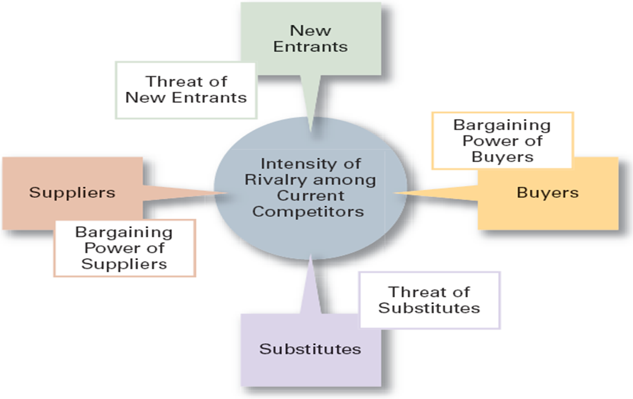
Porter’s Five Forces Model

Slide 10
BARGAINING POWER OF BUYERS
Low
No single buyer has a controlling interest
BARGAINING POWER OF SUPPLIERS
Low
Google’s ad system is a reliable source of income because both the ad-making partner and ad-receiving individual are both customers of Google’s
So due to the market dominance Google has with the search product results in low supplier power

Slide 11
THREAT OF NEW ENTRANTS
THREAT FROM SUBSTITUTES
Low
There are not any true substitutes in this day and age, with the dependence of search increasing day by day.
Low
The barriers to entry in the internet search market are high.
A new entrant would need to provide better search results at very fast speeds to compete in this highly competitive market.

Slide 12
RIVALRY AMONG EXISTING FIRMS
High
This industry is characterized by rapid growth, and fierce competition.
The competitive rivalry is strong and ongoing in this industry because large amounts of advertising dollars flow to the website that has captured the largest volume of searches.
Further, competitors are often in various kinds of legal and advertising battles with one another.

Slide 13
SWOT Analysis
A strategic planning tool that separates influences on a business’s future success into internal and external factors
Strengths
Weaknesses
Opportunities
Threats

Slide 14
STRENGHTS Open source products and services Financial situation Access to the widest group of internet users worldwide Strong patents portfolio Product integration Culture of innovation | I N T E R N A L | WEAKNESSES Only one major source of income Unprofitable products Legal battles over patents
OPPORTUNITIES Obtaining patents through acquisitions Driverless electronic cars Growing into electronics industry Google fiber cables | E X T E R N A L | THREATS Growing number of mobile internet users Unprofitable products EU antitrust laws Competition from Microsoft

Slide 15
RATIO ANALYSIS
EBITDA Margin:
Google | Hewlett-Packard | Microsoft | Apple Inc.
31.52 | 11.53 | 38.12 | 29.34
EBITDA margin = (EBITDA/Net sales)
Google Inc. is doing fairly good as compared to its competitors, only second to Microsoft.

Slide 16
Net Profit Margin:
Google | Hewlett-Packard | Microsoft | Apple Inc.
21.35 | 4.54 | 25.42 | 21.67
In terms of net profit margin, Google Inc. is comparable to its competitors except Hewlett-Packard

Slide 17
Return on Assets:
Google | Hewlett-Packard | Microsoft | Apple Inc.
12.1 | 4.88 | 14.02 | 17.89
This ratio tells us how much profit a company is able to generate for each dollar of assets invested.
Google Inc is lagging behind its competitors Apple and Microsoft, with Apple Inc performing much better than its competitors.

Slide 18
Return on Equity:
Google | Hewlett-Packard | Microsoft | Apple Inc.
15.44 | 19.19 | 26.17 | 29.98
High ROEs can be caused by the firm taking on excessive leverage, which can prove disastrous for the firm’s shareholders in the long run.
As with ROA, a higher is not always better where ROE is concerned.
Google Inc. is far behind all its competitors in-terms of ROE, but a high ROE doesn’t always mean the company is in a good shape.

Slide 19
Current Ratio:
Google | Hewlett-Packard | Microsoft | Apple Inc.
4.56 | 1.16 | 2.5 | 1.68
A current ratio of 2 or above is usually considered safe.
Google Inc. is in a very strong position to pay its current liabilities on time as compared to its competitors.

Slide 20
Price to Earnings Ratio:
Google | Hewlett-Packard | Microsoft | Apple Inc.
30.3 | 14.19 | 17.45 | 37.93
PE ratio is generally high for companies considered to have huge growth potential.
The PE ratio of Google is high because it is an innovation driven company and has a huge growth potential in future; the same logic also justifies high PE of Apple Inc.

Slide 21
Asset Turnover Ratio:
Microsoft | Google | Hewlett-Packard | Apple Inc.
0.55 | 0.57 | 1.07 | 0.83
A high asset turnover is an indicator of good performance.
Google Inc. has an average Asset turnover ratio owing to its huge value of Assets, Hewlett Packard is far better than its competitors in this regard.

Slide 22
Price to Sales Ratio:
Microsoft | Google | HP
4.32 | 6.34 | 0.63
The price-to-sales (per share) ratio is more stable than the price-to-earnings ratio.
It is generally good to have a high Price to Sales Ratio.
Google Inc. is far ahead of its competitors in-terms of Price to Sales ratio.

Slide 23
Debt to Equity Ratio:
Microsoft | Google | HP
0.45 | 0.65 | 0.85
The most widely used measure of a company’s leverage, debt to equity ratios greater than 1 indicate the company may be overleveraged, and stretching itself financially.
Google has an average Debt to Equity Ratio - neither too high nor too low, implying that the company is not over-leveraged.

Slide 24
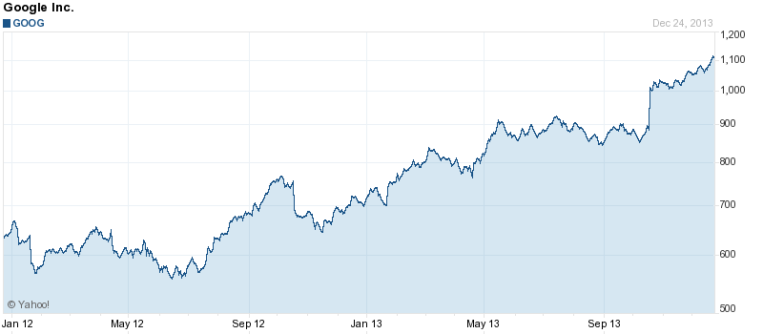
HISTORICAL STOCK PERFORMANCE
+57.18%: Year-to-Date

Slide 25
ANALYST RECOMMENDATIONS AND REVISIONs
1-5 Linear Scale | Current | 1 Month Ago | 2 Month Ago | 3 Month Ago
(1) BUY | 16 | 16 | 16 | 16
(2) OUTPERFORM | 16 | 16 | 16 | 16
(3) HOLD | 13 | 13 | 13 | 13
(4) UNDERPERFORM | 0 | 0 | 0 | 0
(5) SELL | 0 | 0 | 0 | 0
No Opinion | 0 | 0 | 0 | 0
Mean Rating | 1.93 | 1.93 | 1.93 | 1.93

Slide 26
Thanks a lot for your time!
Student, ERI,
Indian Institute of Technology Delhi, India

